Slide 1
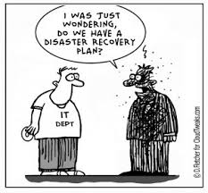
Managing Your Research Data
File Management
Based on slides by Qi Wang & Jing Su

Slide 2
Outline
Data Management Principles
Research Data Life-cycle
Data Management Checklist
Techniques to help organize your research data
File Organization
File Naming
Version Control
Metadata (ReadMe)
Running Low on Storage Space?

Slide 3
Outline
Data Management Principles
Research Data Life-cycle
Data Management Checklist
Techniques to help organize your research data
File Organization
File Naming
Version Control
Metadata (ReadMe)
Running Low on Storage Space?

Slide 4
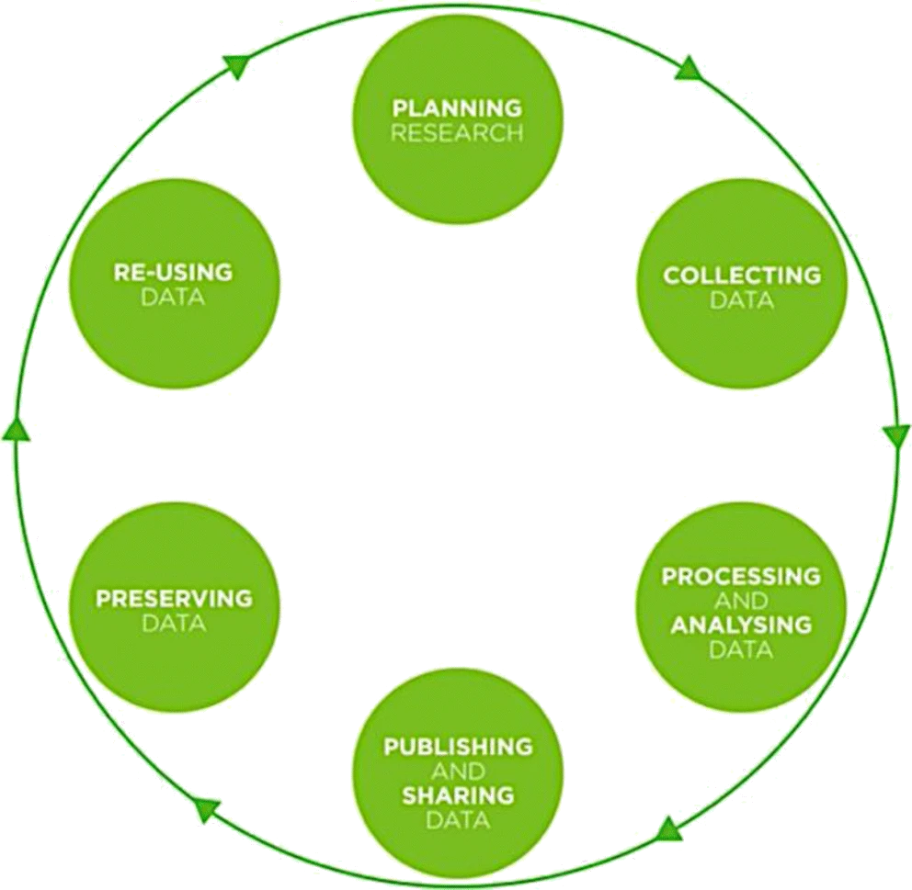
Research Data Life Cycle

Slide 5
Data Management Checklist
What types of data?
Who will be responsible to collect and document the data?
How to collect/document/store/back up/share data?

Slide 6
Data Management Checklist
What types of data?
Experimental – raw data:
Tables of figures
Images
Sequencing data
Geographical
etc.
Processed data/Analysis results
Format and size for each

Slide 7
Data Types Recommended by UK Data Archive
Type of data | Recommended formats
Quantitative tabular data with extensive metadata. Variable labels, code labels, and defined missing values | Proprietary formats of statistical packages e.g. SPSS (.sav), Stata (.dta), .sas7bdat. Delimited text and command (‘setup’) file (SPSS, Stata, SAS, etc.) containing metadata information. Some structured text or mark-up file containing metadata information, e.g. DDI XML file.
Quantitative tabular data with minimal metadata. A matrix of data with or without column | Comma-separated values (CSV) file (.csv). Tab-delimited file (.tab).
Geospatial data. Vector and raster data. | ESRI Shapefile (essential – .shp, .shx, .dbf, optional – .prj, .sbx, .sbn). Geo-referenced TIFF (.tif, .tfw). CAD data (.dwg). Tabular GIS attribute data.
Qualitative data. Textual. | eXtensible Mark-up Language (XML) text according to an appropriate Document Type Definition (DTD) (.xml). Rich Text Format (.rtf)/Plain text data, ASCII (.txt).
Digital image data. | TIFF version 6 uncompressed (.tif). Digital Imaging and Communications in Medicine (DICOM) (.dcm, .dcm30) – for CT/MRI data.
Digital audio data. | Free Lossless Audio Codec (FLAC) (.flac).
Digital video data. | MPEG-4 (.mp4). OGG video (.ogv, .ogg). motion JPEG 2000 (.mj2).
Documentation and scripts. | Rich Text Format (.rtf). PDF/A or PDF (.pdf). HTML (.html). OpenDocument Text (.odt). R Markdown files (.rmd) (with HTML version as well).
Full table at the UK Data Archive website

Slide 8
Data Types Recommended by UK Data Archive
Type of data | Recommended formats
Quantitative tabular data with extensive metadata. Variable labels, code labels, and defined missing values | Proprietary formats of statistical packages e.g. SPSS (.sav), Stata (.dta), .sas7bdat. Delimited text and command (‘setup’) file (SPSS, Stata, SAS, etc.) containing metadata information. Some structured text or mark-up file containing metadata information, e.g. DDI XML file.
Quantitative tabular data with minimal metadata. A matrix of data with or without column | Comma-separated values (CSV) file (.csv). Tab-delimited file (.tab).
Geospatial data. Vector and raster data. | ESRI Shapefile (essential – .shp, .shx, .dbf, optional – .prj, .sbx, .sbn). Geo-referenced TIFF (.tif, .tfw). CAD data (.dwg). Tabular GIS attribute data.
Qualitative data. Textual. | eXtensible Mark-up Language (XML) text according to an appropriate Document Type Definition (DTD) (.xml). Rich Text Format (.rtf)/Plain text data, ASCII (.txt).
Digital image data. | TIFF version 6 uncompressed (.tif). Digital Imaging and Communications in Medicine (DICOM) (.dcm, .dcm30) – for CT/MRI data.
Digital audio data. | Free Lossless Audio Codec (FLAC) (.flac).
Digital video data. | MPEG-4 (.mp4). OGG video (.ogv, .ogg). motion JPEG 2000 (.mj2).
Documentation and scripts. | Rich Text Format (.rtf). PDF/A or PDF (.pdf). HTML (.html). OpenDocument Text (.odt). R Markdown files (.rmd) (with HTML version as well).
Open and non-proprietry
Information loss during conversion
Full table at the UK Data Archive website

Slide 9
Data Management Checklist
What types of data?
Experimental – raw data:
Tables of figures
Images
Sequencing data
Geographical
etc.
Processed data/Analysis results
Format and size for each

Slide 10
Data Management Checklist
Who will be responsible to collect and document the data?
Roles and responsibilities
Legal and ethical obligations and rights

Slide 11
Data Management Checklist
How to collect/document/store/back up/share data?
Reproducibility & re-usability
Restrictions:
Ethical obligations
Legal obligations - privacy and data processing laws
Copyright/Intellectual property

Slide 12
Data Management Checklist
How to collect/document/store/back up/share data?
Reproducibility & re-usability
Restrictions:
Ethical obligations
Legal obligations - privacy and data processing laws
Copyright/Intellectual property
Consider an Electronic Lab Notebook

Slide 13
Choosing an Electronic Lab Notebook
Cost? One-time or subscription(monthly/yearly)?
Access control. Other Users? Collaborators?
Types of information to record and storage space required
Any specialized functionality you require?
Protection for sensitive data
What happens if someone leaves the lab?
What happens when you stop using this ELN?

Slide 14
Choosing an Electronic Lab Notebook
Further Reading:
Kwok, Roberta. 2018. How to pick an electronic laboratory notebook. Nature 560 (7717): 269-270
The Electronic Lab Notebook in 2023: A comprehensive guide
Electronic Lab Notebook guide from Harvard Data Management

Slide 15
Data Management Checklist – 13 core questions
What data will you collect or create?
How will the data be collected or created?
What documentation and metadata will accompany the data?
How will you manage any ethical issues?
How will you manage copyright and Intellectual Property Rights (IPR) issues?
How will the data be stored and backed up during the research?
How will you manage access and security?
What is the long-term preservation plan for the dataset?
Which data should be retained, shared, and/or preserved?
How will you share the data?
Are any restrictions on data sharing required?
Who will be responsible for data management?
What resources will you require to deliver your plan? (people, time, hardware)
Full Checklist with guidance can be downloaded from the DCC website here

Slide 16
Outline
Data Management Principles
Research Data Life-cycle
Data Management Checklist
Techniques to help organize your research data
File Organization
File Naming
Version Control
Metadata (ReadMe)
Running Low on Storage Space?

Slide 17
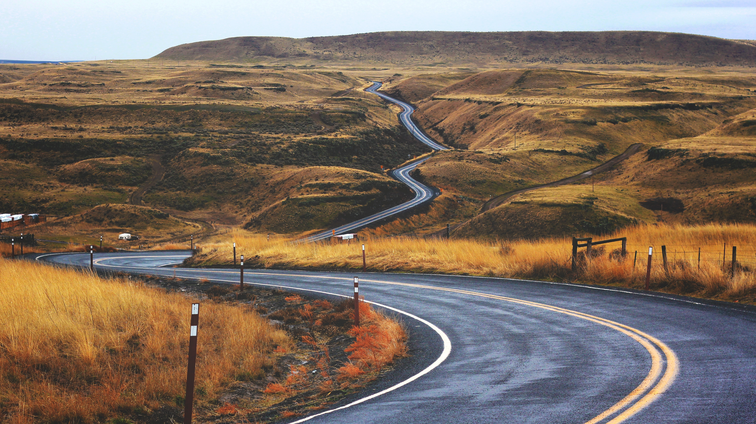
No one has
perfect data management habits,
but adopting even a few
goes a long way.

Slide 18
Outline
Data Management Principles
Research Data Life-cycle
Data Management Checklist
Techniques to help organize your research data
File Organization
File Naming
Version Control
Metadata (ReadMe)
Running Low on Storage Space?

Slide 19
File Organization
Ways to organize electronic files
Hierachical – files organized in folders and sub-folders
Tag-based – each file is assigned one or more tags

Slide 20
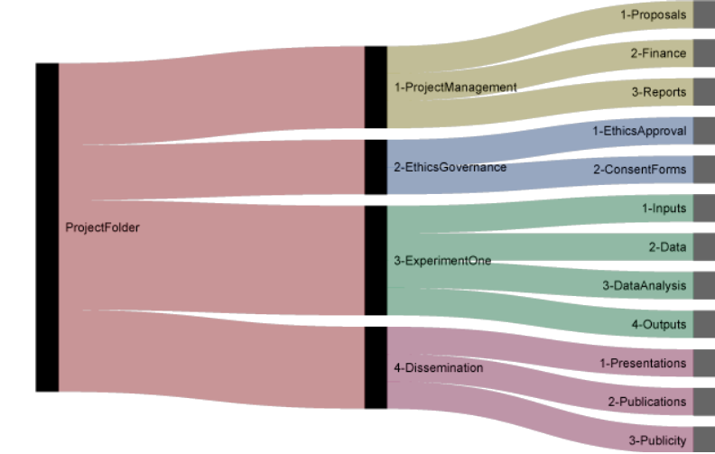
Hierachical folder structure
From: http://nikola.me/folder_structure.html

Slide 21
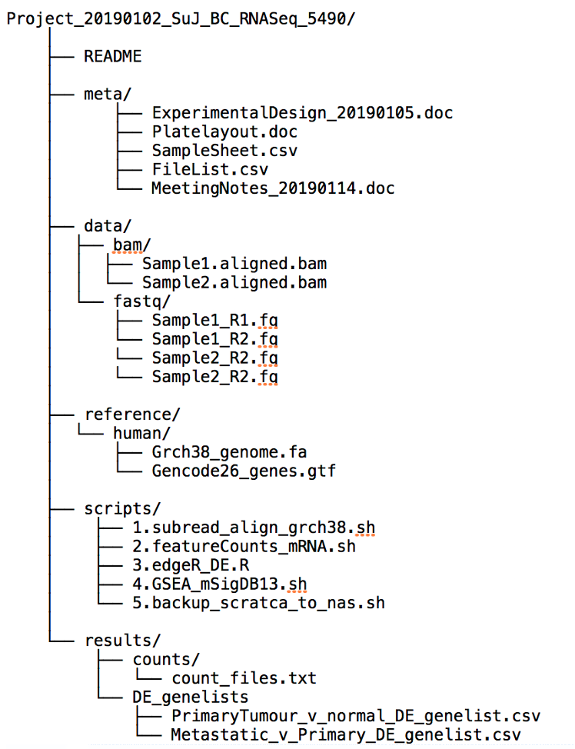
Hierachical folder structure

Slide 22
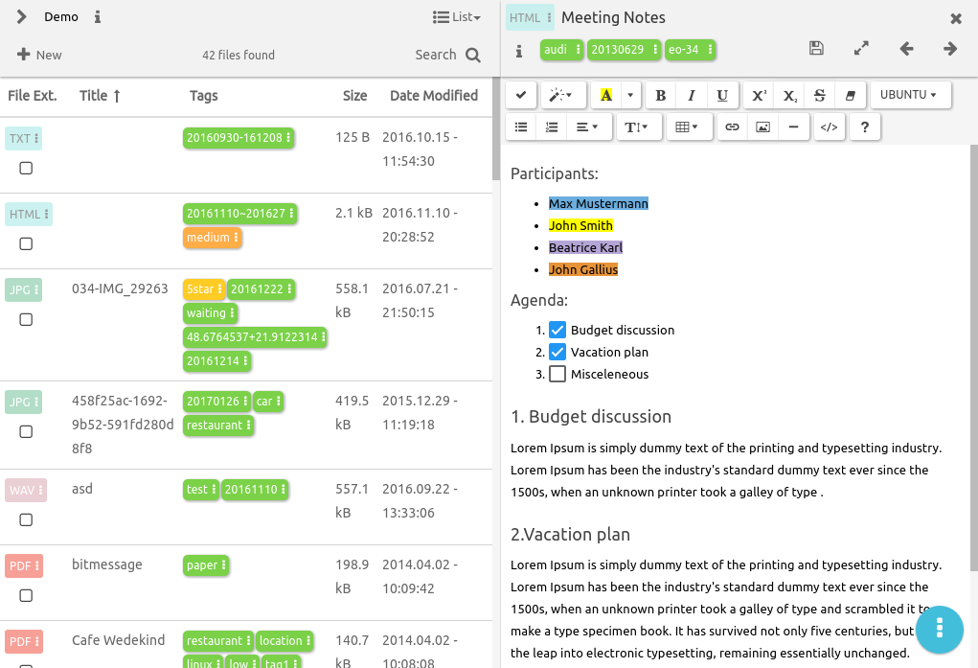
Tag based organization
More about tagging: https://libguides.mit.edu/metadataTools

Slide 23
Outline
Data Management Principles
Research Data Life-cycle
Data Management Checklist
Techniques to help organize your research data
File Organization
File Naming
Version Control
Metadata (ReadMe)
Running Low on Storage Space?

Slide 24
File Naming – the three Cs
Criteria: Can your collaborator (or you in 5 years time) identify the content of the file without opening it?
Clear
Objective
✗ my, current, latest, final
✓JohnSmith, 20220418, version_1.0
Meaningful: “He”?
Concise
e.g. omit “the”, “and” etc.
Consistent
Have a defined naming convention e.g. [Date]_[Run]_[SampleType]_[SampleID]

Slide 25
File Naming – other tips
Use underscores “_” to separate elements
Compare:
Averagetrendclustering20220814.png
Average_trend_clustering_20220814.png
Do not use spaces or other special characters
Use periods “.” only prior to the file extension
Use leading zeros when using numbers in file names
Sample_01.png rather than Sample_1.png

Slide 26
File Naming – have a go…
This is a bad file name:
my Data @DryValley November 15 2010.v2.dat
How would you revise based on the principles discussed?
Type your proposal in the zoom chat window.

Slide 27
File Naming – have a go…
This is a bad file name:
my Data @DryValley November 15 2010.v2.dat
A better option:
DV_ICPOES_20101115_JDS_v02.dat
DV: site code (Dry Valley)
ICPOES: instrument name
20101115: date of data generation
JDS: initials of the scientist
v02: second version

Slide 28
Batching Renaming Tools
Windows:
• Ant Renamer
• Bulk Rename Utility
Mac:
• Renamer6
• Name Mangler
Linux/Unix:
• GNOME Commander
• Use grep, sed and awk to search for and change file names

Slide 29
Outline
Data Management Principles
Research Data Life-cycle
Data Management Checklist
Techniques to help organize your research data
File Organization
File Naming
Version Control
Metadata (ReadMe)
Running Low on Storage Space?

Slide 30
Version Control
Why?
Track changes
Enable reverting to earlier version
How?
File naming (manually)
Date - Template_soil _testing_20120319.xlsx
Author’s name - Template_soil _testing_by_AS.xlsx
Version number - Template_soil _testing_v03_02.xlsx
v01, v02 for major edit; v01_0, v01_1, v01_2 for minor edit
Version control tools (automatic)
Wet lab
Electronic Lab Notebooks(ELN)
Laboratory Information Management System(LIMS)
Dry lab
Git (GitHub/GitLab)
Subversion

Slide 31
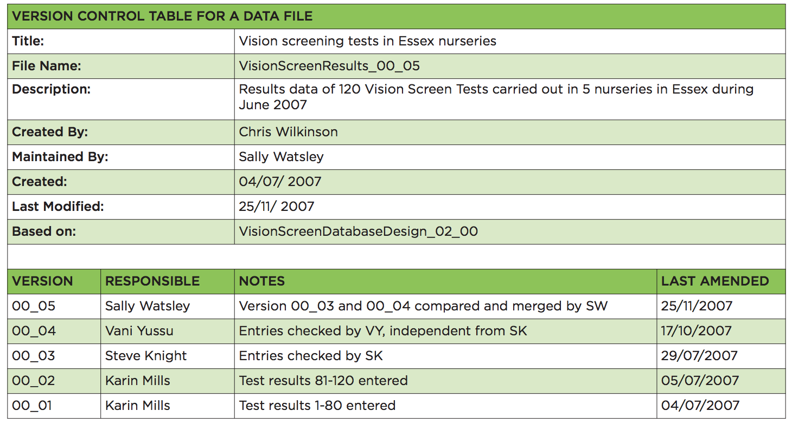
Version Control

Slide 32
Outline
Data Management Principles
Research Data Life-cycle
Data Management Checklist
Techniques to help organize your research data
File Organization
File Naming
Version Control
Metadata (ReadMe)
Running Low on Storage Space?

Slide 33
Metadata
What is metadata?
Description that helps someone else understand the contents and organization of your files in your absence
What should metadata include?
What?
Who?
Where & When?
How?
@ Project level @ Data level @ File level

Slide 34
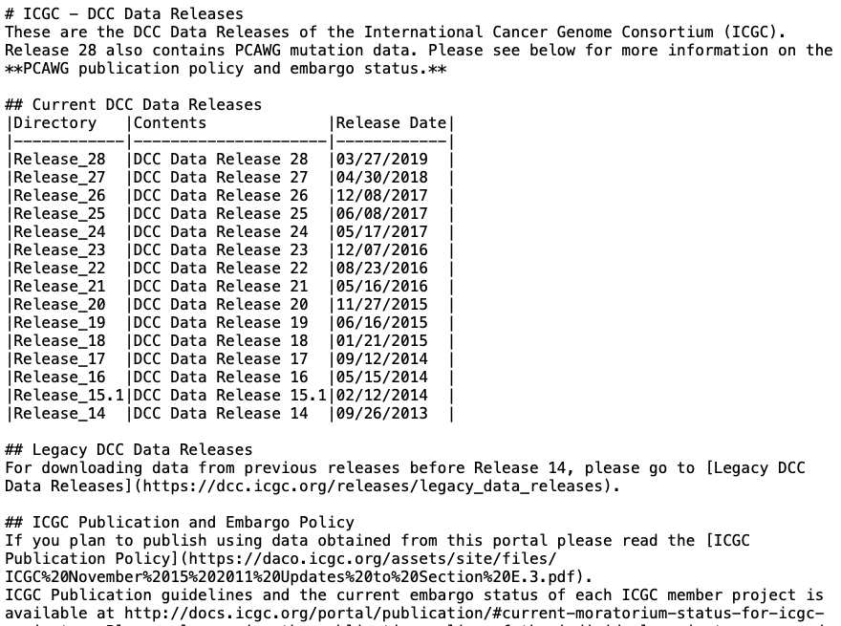
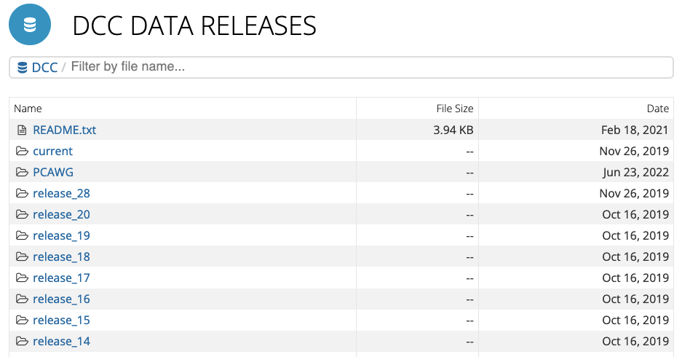
Metadata - @Project level
https://dcc.icgc.org/releases

Slide 35
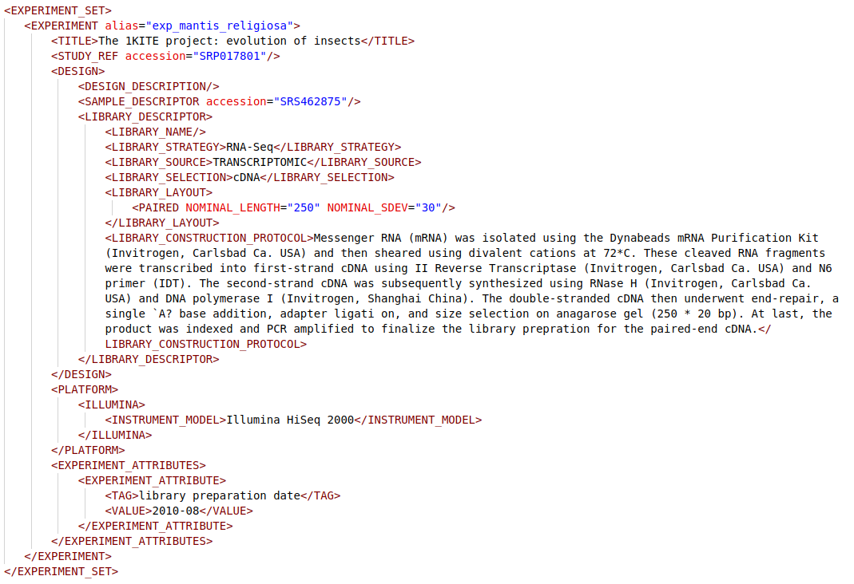
Metadata - @Data level
https://ena-docs.readthedocs.io/en/latest/submit/reads/programmatic.html

Slide 36
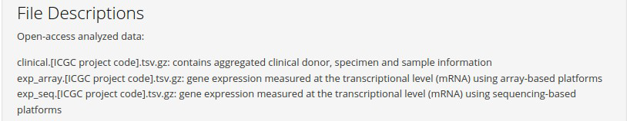
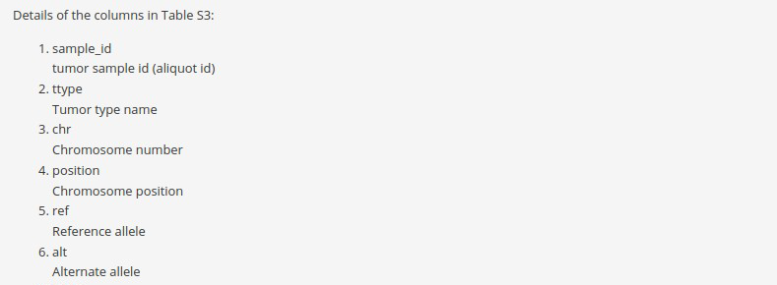
Metadata - @File level

Slide 37
Metadata
Further reading on metadata and README files from Cornell University

Slide 38
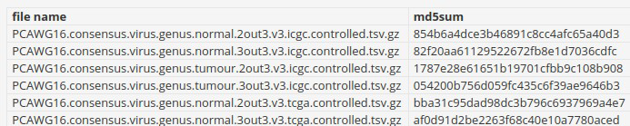
Metadata – avoiding file corruption
When copying, moving, downloading or uploading files, it is possible that the file may be corrupted or truncated.
We can check this using an MD5 checksum
MD5 checksums are like “fingerprints” for files
Any alterations to the file will cause the MD5 checksum to change

Slide 39
Outline
Data Management Principles
Research Data Life-cycle
Data Management Checklist
Techniques to help organize your research data
File Organization
File Naming
Version Control
Metadata (ReadMe)
Running Low on Storage Space?

Slide 40
Running out of Space – Do we need all the files?
Five steps to decide what data to keep:
Identify purposes that the data could fulfil
Identify data that must be kept
Identify data that should be kept
Weigh up the costs £££
Complete the data appraisal
For more details:
https://www.dcc.ac.uk/guidance/how-guides/five-steps-decide-what-data-keep

Slide 41
Summary
Principle: Can someone else (as well as yourself years from now) understand the contents and organization of your files in your absence.
Data Management Checklist
What?
Who?
How?
File Structure & File Name (3C)
Metadata (ReadMe) @Project-level @Data-level @File-level
Keep track of changes with Version Control
Avoid pitfalls in data transfer using md5sum check

